Slide 1


Used Car in aibuquerque
Reggie Amankwatiah
DATA 200- Data Analysis Project

Slide 2

Business situation & objective
The company buys and resells used vehicles in Albuquerque
Leadership needed insights from public Craigslist listings
Goal: Find trends in price, vehicle types, and features
Data-driven insights will guide buying, pricing, and marketing
Notes:
I was asked to review public Craigslist vehicle listings in Albuquerque. The company needed help identifying which types of vehicles are most common, how features like mileage or condition affect pricing, and what brands hold the most value. The goal is to use these patterns to make smarter buying decisions and guide how we price and promote inventory.

Slide 3
Data overview & preparation
Craigslist used car listings (Albuquerque region)
4,902 records across 23 fields
Key fields: price, year, odometer, brand, condition
Cleaned by removing:
– Rows with missing price, year, or odometer
– Listings with price = $0 or odometer > 1M
– Vehicle years before 1980 or after 2022
Notes:
I worked with a dataset containing nearly 5,000 used vehicle listings from Craigslist in Albuquerque. It included 23 fields, but I focused on the most important ones — price, year, mileage, brand, type, and condition. To ensure accuracy, I cleaned the data by removing any listings with missing or unrealistic values — for example, cars with a price of zero or mileage over a million. I also filtered out cars with very old or future manufacturing years. This prep work helped ensure my analysis would reflect meaningful, trustworthy trends

Slide 4

Key question I explored
What features affect a car’s price the most?
Which brands hold value better in Albuquerque?
What car years are most common in listings?
How does mileage impact pricing across types?
Which fuel types and transmissions are most listed?
Notes:
After cleaning the data, I focused my analysis on questions that would help our team make smarter decisions. I wanted to understand what features actually drive price — things like brand, condition, year, and mileage. I also looked at which years and vehicle types show up most often, and explored how fuel type and transmission affect value. These questions helped shape the PivotTables and charts I created in Excel.

Slide 5
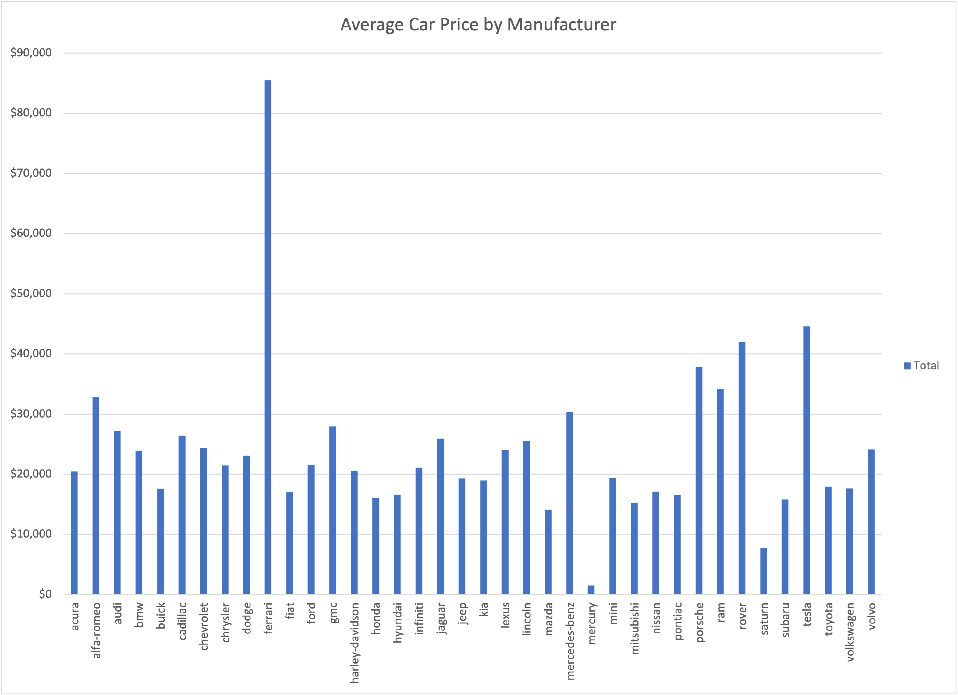
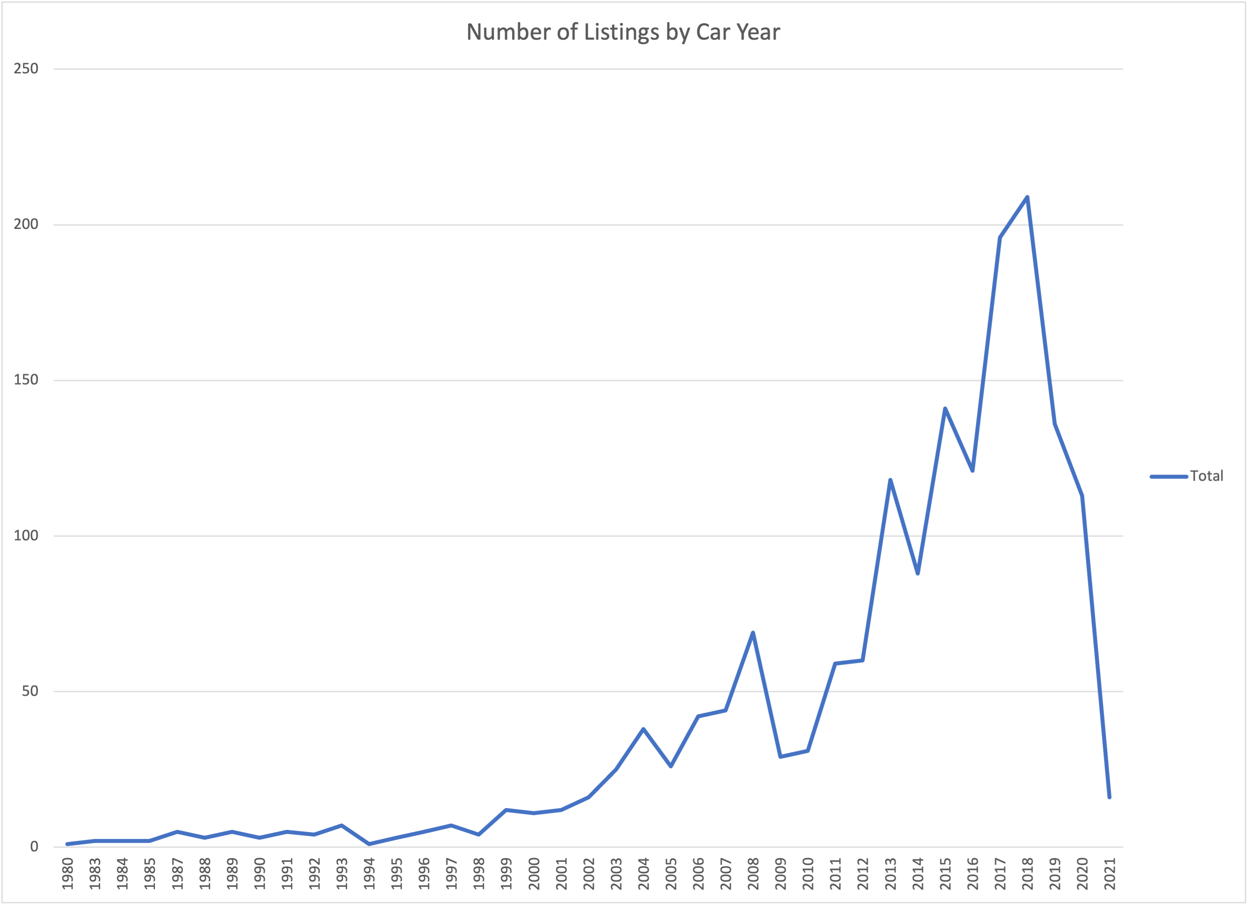
Visual insights: vehicle prices & years
Under Chart 1: "Ferrari, Tesla, and Porsche lead in average price; Toyota and Subaru show strong resale value among non-luxury brands."
Under Chart 2: "Listings peak between 2012–2017, showing strong inventory for mid-age cars.
Notes:
In the first chart, we see that luxury brands like Ferrari and Porsche have the highest average car prices — no surprise there. What’s more useful for our business is how brands like Toyota, Subaru, and Mercedes-Benz perform. They show solid average prices, suggesting better resale value even outside of luxury markets.
The second chart shows that most listings are concentrated between 2012 and 2017. This tells me that customers are frequently listing mid-age vehicles, which are likely the sweet spot for resale: not too old, but not brand new either.

Slide 6
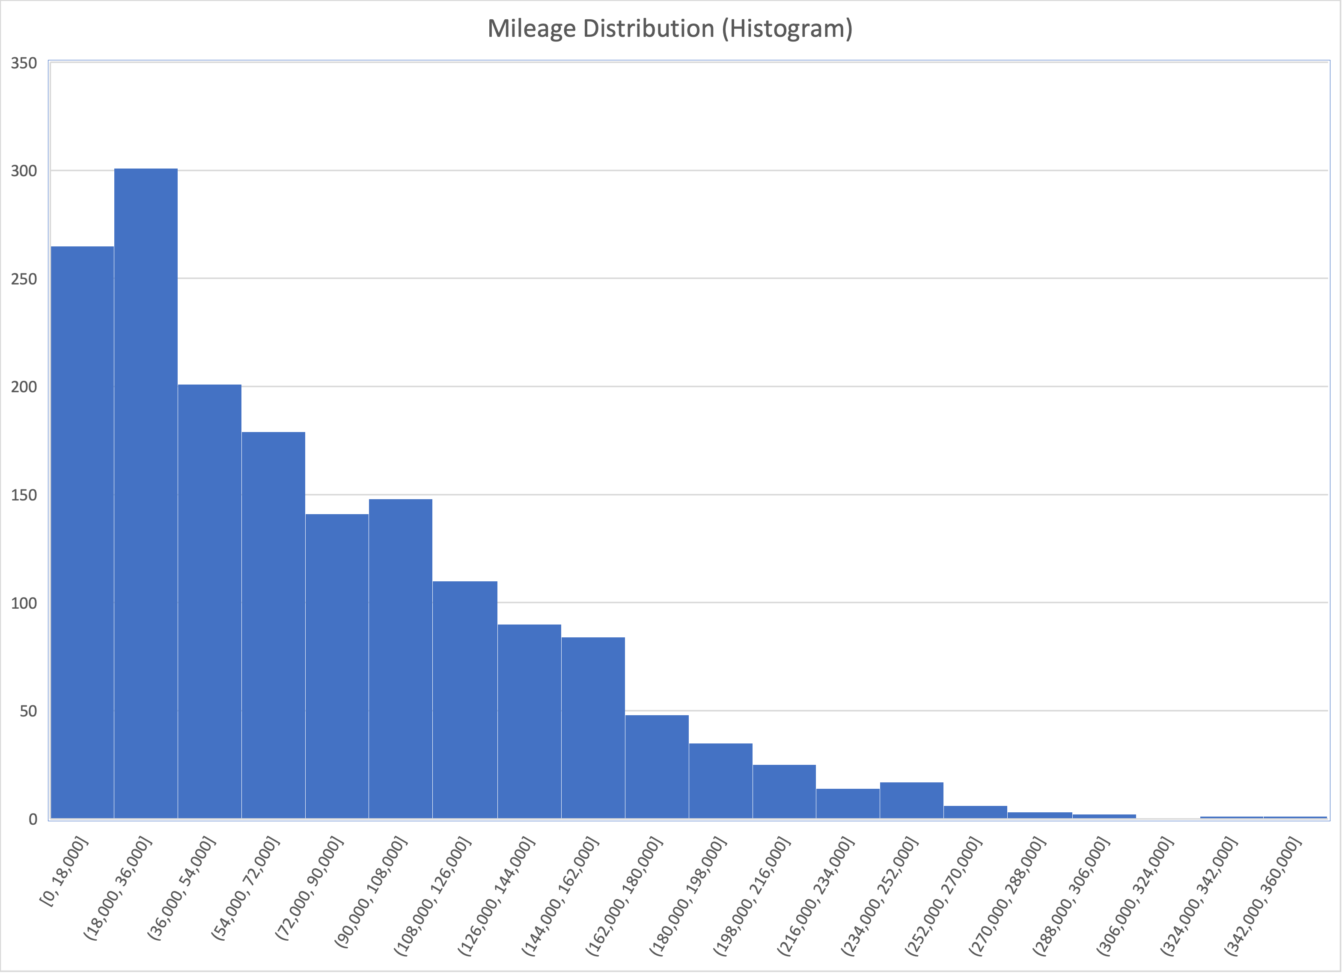
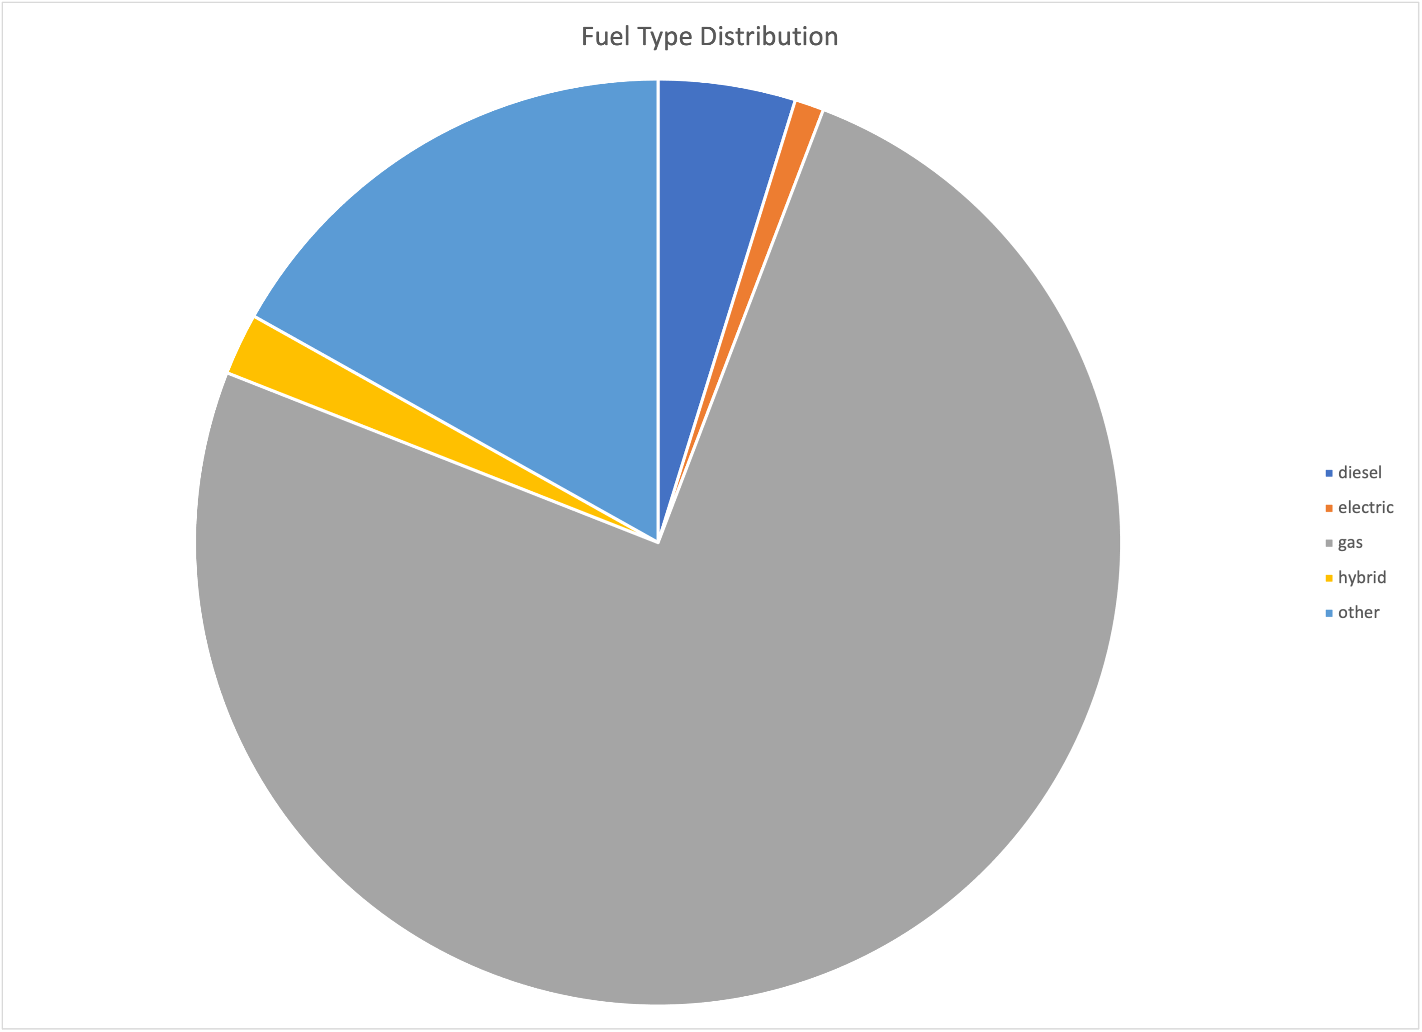
Visual insights: mileage & fuel type
Histogram: “Most listings have under 100,000 miles — ideal for resale.”
Pie Chart: “Gas dominates fuel type, while electric and hybrid are rare.”
Notes:
Starting with mileage: as you can see, the majority of vehicles fall below 100,000 miles, with the highest concentration between 0 and 60,000. That’s a great range for resale — not too old, but still affordable.
Now looking at fuel type, gas-powered cars make up nearly the entire market in Albuquerque. Electric, hybrid, and diesel listings are extremely limited. This shows traditional fuel is still the norm in this area — we shouldn’t invest heavily in electric inventory just yet.

Slide 7
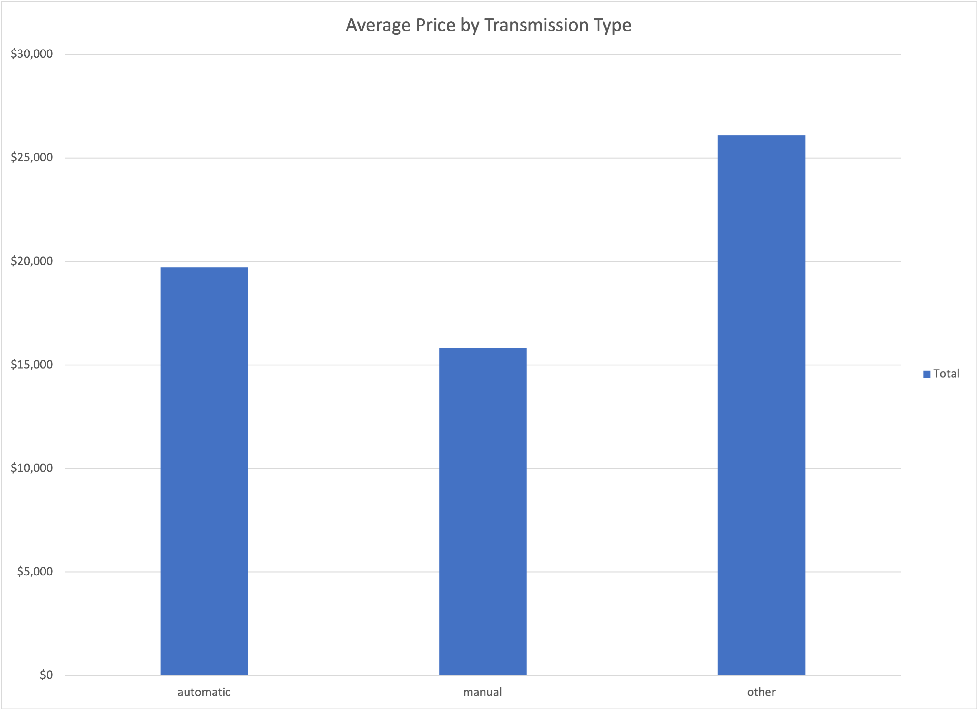
Visual insight: price by transmission type
Automatic vehicles are more common and listed at higher average prices.
Notes:
When I compared price by transmission type, automatics clearly had a higher average price than manual cars. They’re also much more common in the listings. This suggests demand for automatics is higher, and we should prioritize those when sourcing vehicles for resale. Manuals may take longer to sell and yield lower profit margins.

Slide 8
Final Analysis & Recommendations
Focus on vehicles under 100,000 miles — they sell faster.
Prioritize automatic cars; higher resale value and demand.
Stick with gas-powered vehicles — electric inventory is still too limited.
Popular brands like Toyota, Ford, and Honda should be main targets.
Watch for overpriced listings; Ferrari skewed average pricing data.
Notes:
Based on everything we analyzed, here are my key recommendations:
We should mainly source cars with less than 100,000 miles — the data shows they dominate the listings and are in high demand.
Automatics should be prioritized because they have higher average prices and are more common.
While electric and hybrid vehicles are growing elsewhere, Albuquerque is still heavily gas-based. So for now, let’s avoid stocking up on EVs.
Toyota, Ford, and Honda are among the most frequently listed — and more affordable — which makes them great inventory targets.
Lastly, we should ignore extreme outliers like Ferrari when analyzing average prices. They distort the true picture and don’t represent our actual inventory strategy.

